Slide 1
Bootcamp_Data Engineering Training
Prepared By,
Srimathi Chandrasekaran
13/05/2022

Slide 2
Chapter1: BigData EcoSystem & Linux
Intro to BigData EcoSystem - OK
HDFS & YARN - OK
MapReduce & Sqoop – Today 13/05/2022
Hbase & Impala
Hive & HiveQL
Linux Scripting

Slide 3
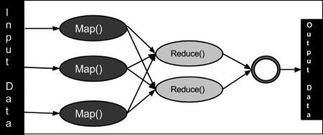
MapReduce
Mapper and Reducer. => MapReduce is a framework, processing technique and a program model for distributed computing based on java. The MapReduce algorithm contains two important tasks, namely Map and Reduce. Map takes a set of data and converts it into another set of data, where individual elements are broken down into tuples (key/value pairs). Secondly, reduce task, which takes the output from a map as an input and combines those data tuples into a smaller set of tuples.
Mapper class has map() function that reads the data, process it, generates key value pairs.
Reducer class has reduce() function that shuffle, sort , aggregate intermediate key value pairs (tuples) from mapper to set of smaller tuples.

Slide 4
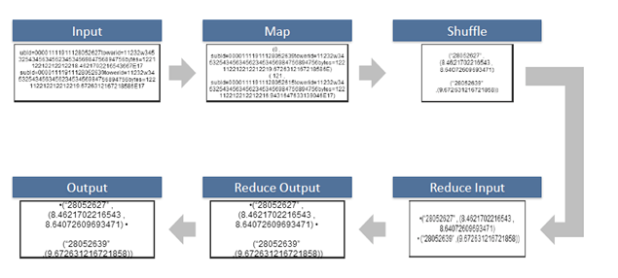
Play a video for Word count example using MapReducer

Slide 5
Sqoop
Sqoop is an open source framework provided by Apache. It is a command-line interface application for transferring data between relational databases and Hadoop
Our Sqoop topics includes all topics of Apache Sqoop with Sqoop features, Sqoop Installation, Starting Sqoop, Sqoop Import, Sqoop where clause, Sqoop Export, Sqoop Integration with Hadoop ecosystem etc.
Before learning Sqoop, you must have the knowledge of Hadoop and Java.
Step 1: Sqoop send the request to Relational DB to send the return the metadata information
about the table(Metadata here is the data about the table in relational DB).
Step 2: From the received information it will generate the java classes
(Reason why you shouldhave Java configured before get it working-Sqoop internally uses JDBC API to generate data)

Slide 6
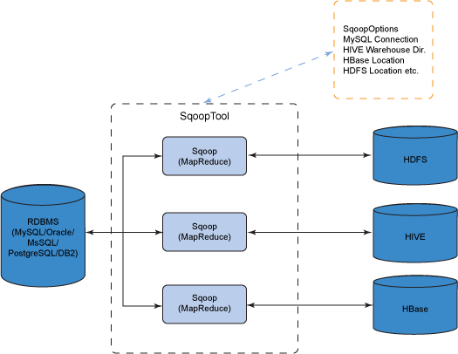
. Step 3: Now Sqoop (As its written in java ?tries to package the compiled classes to beable togenerate table structure) , post compiling creates jar file(Java packaging standard)..

Slide 7
Starting Sqoop:
Sqoop is a command line tool with following structure
sqoop TOOL PROPERTY_ARGS SQOOP_ARGS [-- EXTRA_ARGS]
TOOL indicates the operation eg: "import", "export".
PROPERTY_ARGS are Java properties in the format "-Dname=value"
SQOOP_ARGS mention various Sqoop parameters
EXTRA_ARGS are for specialized connectors, separated from the SQOOP_ARGS with a "--"
Example:
% sqoop import --connect jdbc:mysql://localhost/hadoopguide --table widgets -m 1
Type "sqoop help" to get all the tools available.

Slide 8
Sqoop Import:
Importing "countries" table into our HDFS environment:
$ sqoop import --connect "jdbc:mysql://localhost/training" --username cloudera -P --table
cloudera -target-dir /user/country_imported
Type above command in a single line.
Here -m 1 specifies one mapper for each table. All the tables are downloaded indefault directory.The default number of mappers used is 4. You can change this by appending the command by "-m number_of_mappers".

Slide 9
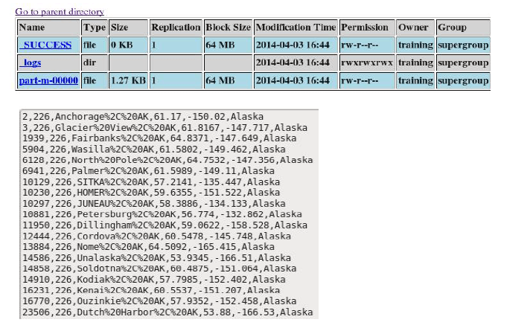
Sqoop Where
You can place restrictions on data imported by using "where" clause. Let's import cityByCountry table where state
The Sqoop statement is written below
sqoop import \ --connect "jdbc:mysql://localhost/training" \ --username training -P \ --table cityByCountry \ --target-dir /user/where_clause \ --where "state = 'Alaska'" \ -m 1
Output is shown below

Slide 10
Sqoop Export
$ sqoop list-databases --connect "jdbc:mysql://localhost" --username cloudera --password cloudera
Similarly for listing tables
$ sqoop list-tables --connect "jdbc:mysql://localhost/training" --username cloudera -P
Using "export" tool, we can import data from HDFS to RDBMs. Before performing export, Sqoop fetches table metadata from MySQL database. Thus we first need to create a table with required metadata.

Slide 11
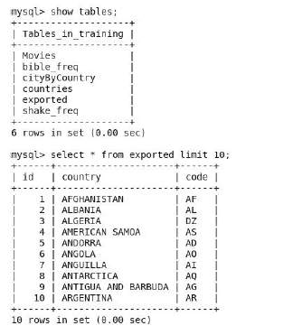
Table creation in MySQL
mysql>Create table table_name( column_name column_type )
Export query is shown below:
Sqoop query sqoop export \ --connect jdbc:mysql://localhost/cloudera\ --username cloudera -P \ --table exported \ --export-dir /user/country_imported/part-m-00000
Now, see output in MySQL by following code.
mysql> select * from exported.

Slide 12
Sqoop Integration with Hadoop Ecosystem
Till now data was moved between RDBMS to HDFS. This imported data may further be required code analysed using hive or hbase.
Sqoop offers property to directly import data to Hive / Hbase.
Just add "--import-hive" at the end of the command.
Example:
sqoop import \ --connect "jdbc:mysql://localhost/training" \ --username training -P \ --table cityByCountry \ --target-dir /user/where_clause \ --where "state = 'Alaska'" \--import -hive -m 1

Slide 13
Thank You!

